Slide 1
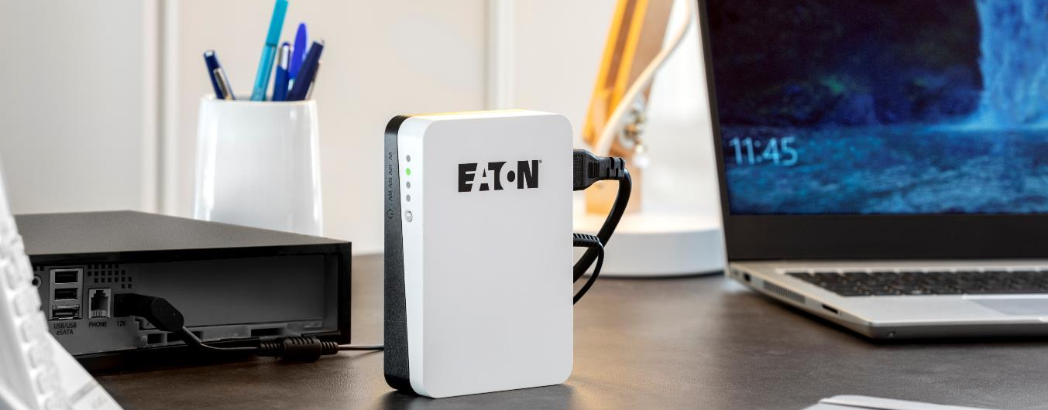
Eaton 3S Mini - 36W DC UPS
Power protection for residential DC applications
© 2021 Eaton, All rights reserved.

Slide 2
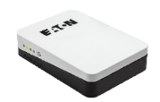
Value Proposition
Secure service continuity for connected equipment during power outages thanks to an affordable and compact DC UPS providing power to Internet routers, IP cameras, Home assistants and Smart controllers.
Value proposition |  | Why It Matters?
Internet connection reliability |  | Internet gateway continues operating during power outage ensuring uninterrupted connection for professional (home office) or residential (smart-home, gaming) purposes.
Remote or local home control |  | Security home systems are protected, including smart-home routers, personal assistants, IP cameras or access control devices.
Smooth integration |  | Offers enhanced Industrial Design together with compact protection solution.
© 2021 Eaton, All rights reserved.

Slide 3
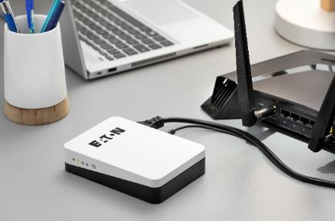
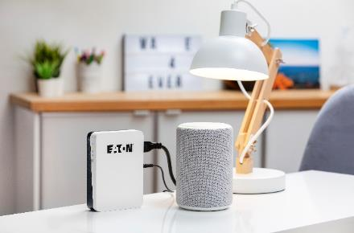
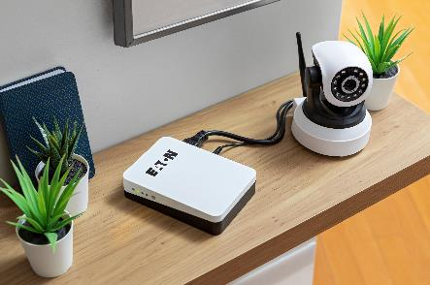
Why a 3S Mini? – Use cases
Use case #1:
Internet router securing home office activity
Use case #2:
Personal assistant maintaining smart devices control or entertainment
Use case #3:
IP camera to keep monitoring your home
Other examples of usage:
Wifi extenders to secure network operation
Standard phones to maintain communication up and running
And so many more!
© 2021 Eaton, All rights reserved.

Slide 4
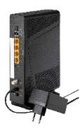
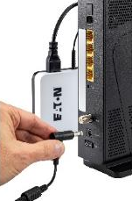
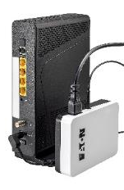
Why a 3S Mini? - Benefit
Initial installation
Typical stand-alone DC application needs an AC-DC transformer to be powered. This offers no power protection
Protected installation
3S Mini replaces the original power supply and protects the application (similar size and no additional cable)
© 2021 Eaton, All rights reserved.

Slide 5
Peace of mind
Runtime
Output protection
Integrated auto-resettable current and voltage limitation (3,5A / 20V)
 | Typical runtime
IP camera (3 Watts) | Up to 5 hours
TV player (~4 Watts) | Up to 4 hours
Wifi extender (7 Watts) | Up to 2 hours
Basic Internet gateway (9 Watts) | 80 minutes
Advanced Internet gateway (15 Watts) | 40 minutes
© 2021 Eaton, All rights reserved.

Slide 6
Easy to use
Output voltage selection
9V, 12V, 15V, 19V
Pre-set at 12V to be immediately compatible with most applications
Cold start function available to be used as a power bank
4-LED battery capacity indicator
© 2021 Eaton, All rights reserved.

Slide 7
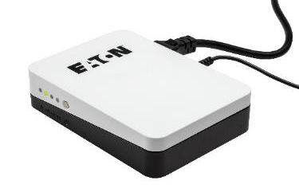
Integration
Compact and appealing
Same design as Eaton 3S Gen2 & Protection Box
4 x adaptors provided
3,5 x 1,5mm
4,75 x 1,7mm
5,5 x 2,1mm
5,5 x 2,5mm
© 2021 Eaton, All rights reserved.

Slide 8
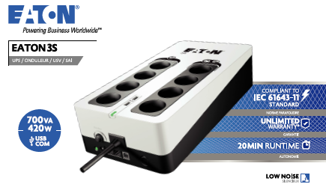
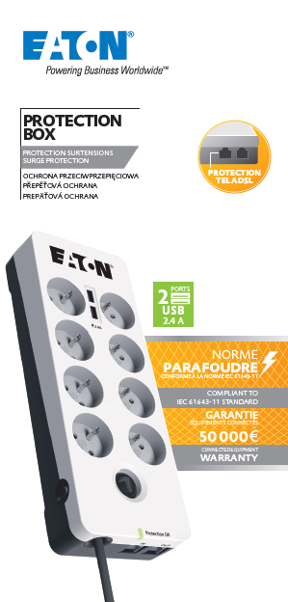
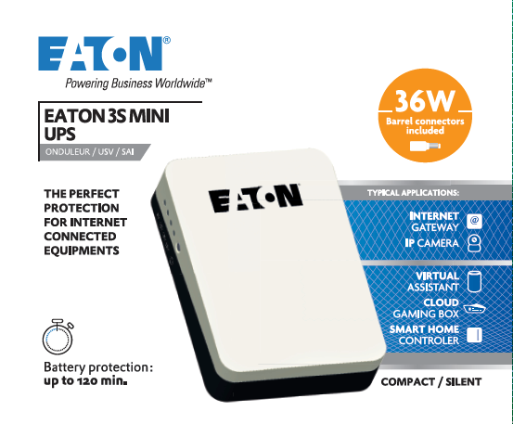
Residential offer identity
Eaton new Design Line, identical to Eaton 3S Gen2 & Protection Box
© 2021 Eaton, All rights reserved.

Slide 9
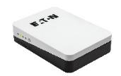
Range overview
 | 3SM36 | 3SM36B
9V / 12V / 15V / 19V selectable output voltage
4 Barrel adaptors
Battery capacity indicator
Local input cable | Schuko/French | BS
Connected equipment warranty | 2 Years | 2 Years
© 2021 Eaton, All rights reserved.

Slide 10
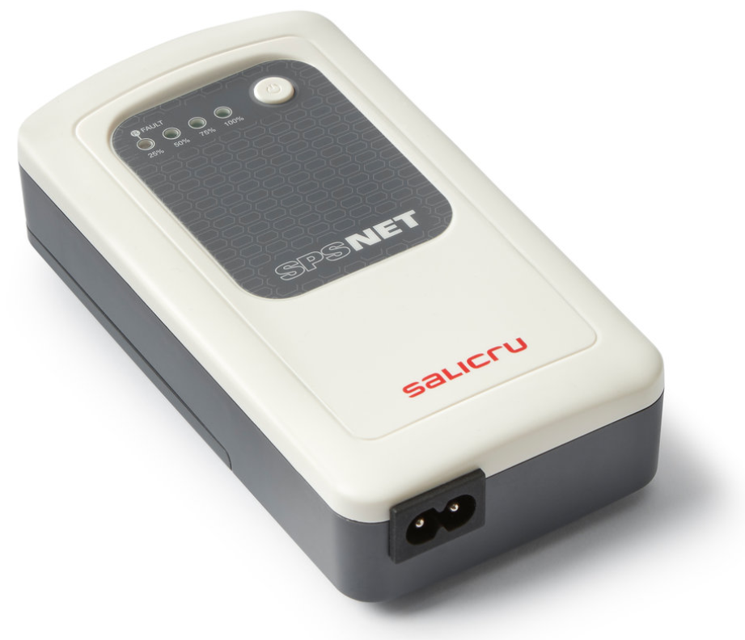
Competitor comparison
 | Eaton 3S Mini 36 | Legrand KEOR DC | Salicru SPS NET
Aesthetic
Power | 36W | 25W | 2x12W
Output voltages | 9V / 12V / 15V / 19V | 9V / 12V / 15V / 19V | 12V
Output voltage indicator | Yes | Yes | Yes
DC Barrel adaptors | 3,5 x 1,5mm 4,75 x 1,7mm 5,5 x 2,1mm 5,5 x 2,5mm | 3,5 x 1,5mm 4,75 x 1,7mm 5,5 x 2,1mm 5,5 x 2,5mm | 5,5 x 2,1mm 5,5 x 2,5mm
Battery capacity | 2 x 2200mAh | 1 x 2200mAh | 3 x 2600mAh
Battery capacity indicator | Yes | Yes | Yes
Warranty | 2 Years | 2 Years | 3 Years
© 2021 Eaton, All rights reserved.
Notes:
Faire des tests à 10W et 15W pour comparaison des deux produits

